Slide 1

Mood-Based Food Recommender for New Delhi
Our project aims to recommend restaurants based on user moods, leveraging data mining techniques and datasets.
User Moods: The moods we focus on include stress, laziness, happiness, depression, hunger, cold weather, etc.
Target Audience: Our solution is designed for users aged between 15-30, based on the preferences of college students.

Slide 2
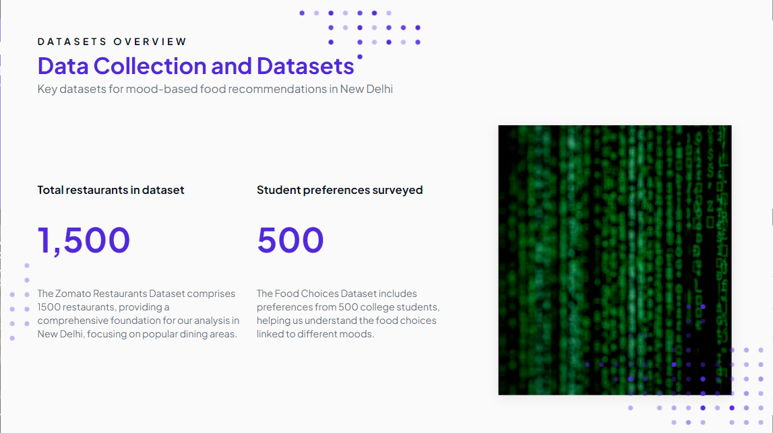

Slide 3
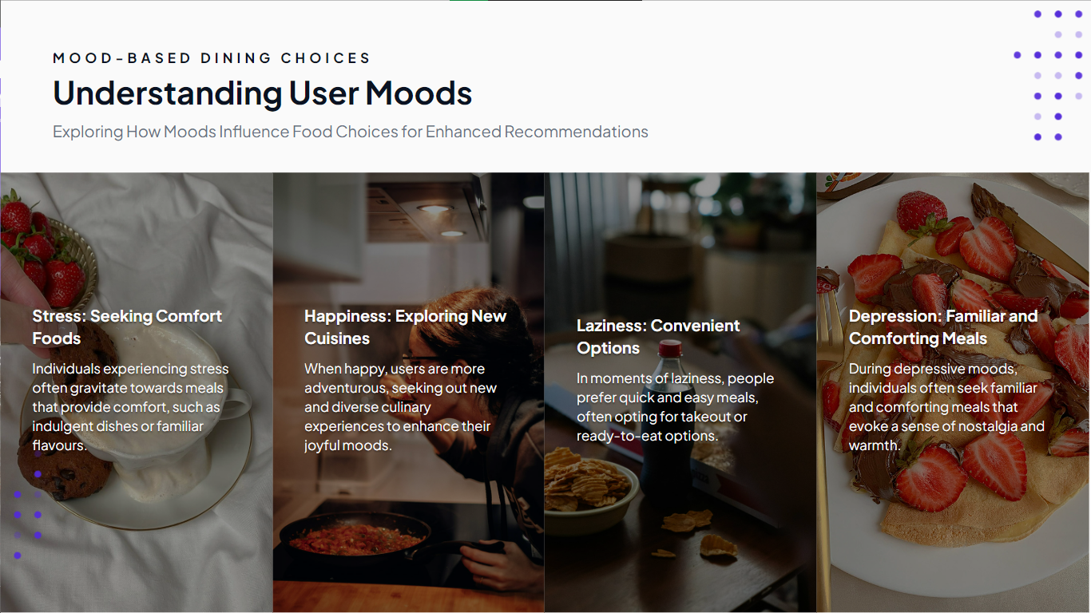

Slide 4
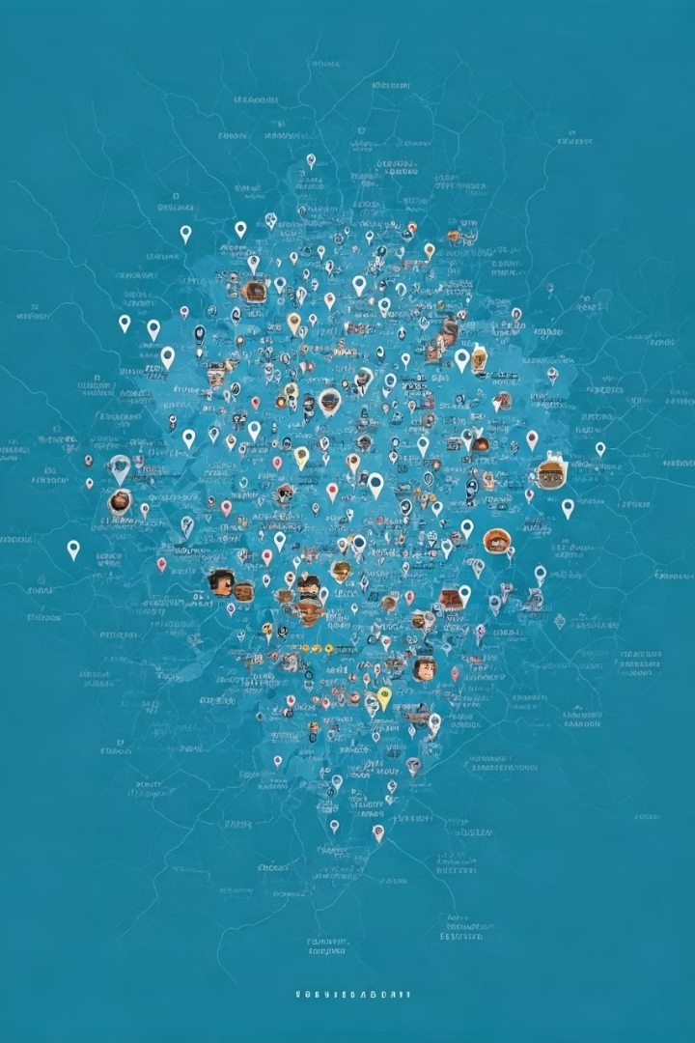
Data Cleaning & Feature Engineering
1
Outlier Removal
Outliers in the Zomato dataset are removed based on factors like latitude, longitude, and ratings to ensure data quality and a reliable model.
2
Cuisine Categorization
We categorize cuisines based on the number of cuisines offered by each restaurant. Fusion cuisines are categorized to provide a clear understanding of the restaurant's offerings.
3
Location Filtering
Restaurant data is filtered based on location relevance to focus on Central Delhi and its surrounding areas, where our target audience is likely to be.
4
Mood-to-Food Mapping
We use lemmatization and NLTK preprocessing to map specific mood terms to comfort foods, providing a foundation for personalized recommendations.

Slide 5
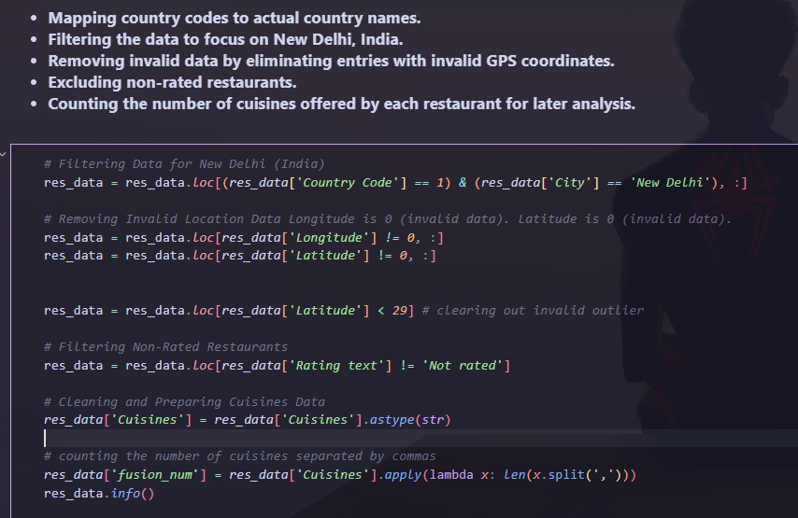

Slide 6
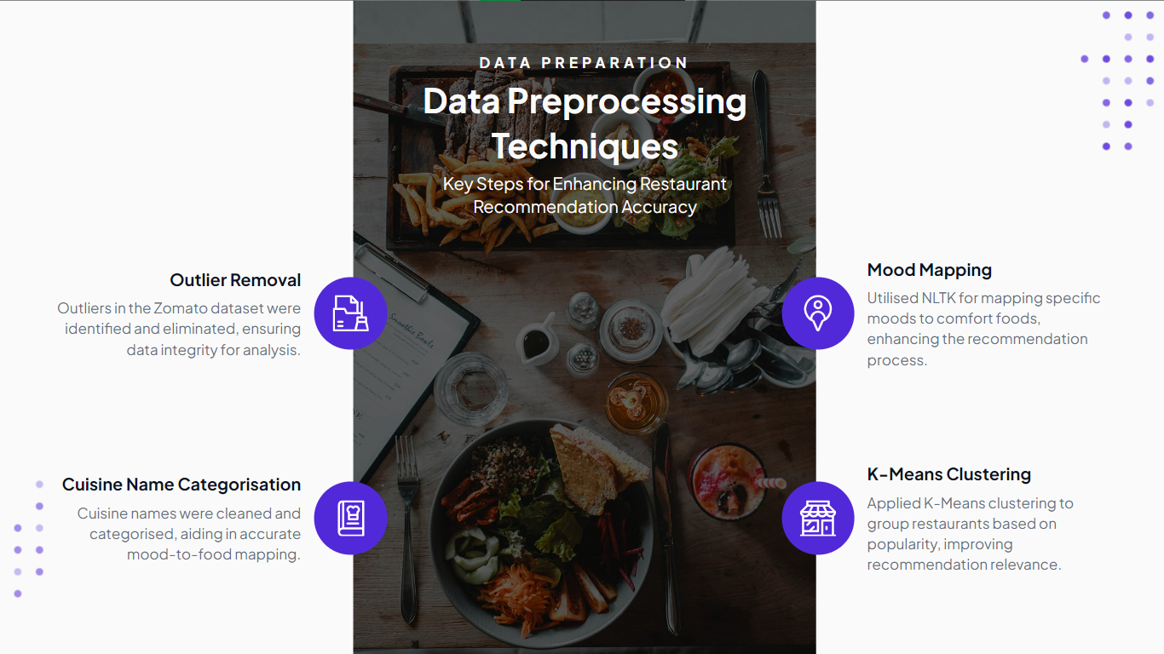

Slide 7
Clustering
K-Means Clustering
We use K-Means clustering to identify areas in Delhi with high concentrations of popular and well-rated restaurants, providing a valuable insight for recommendations.

Slide 8
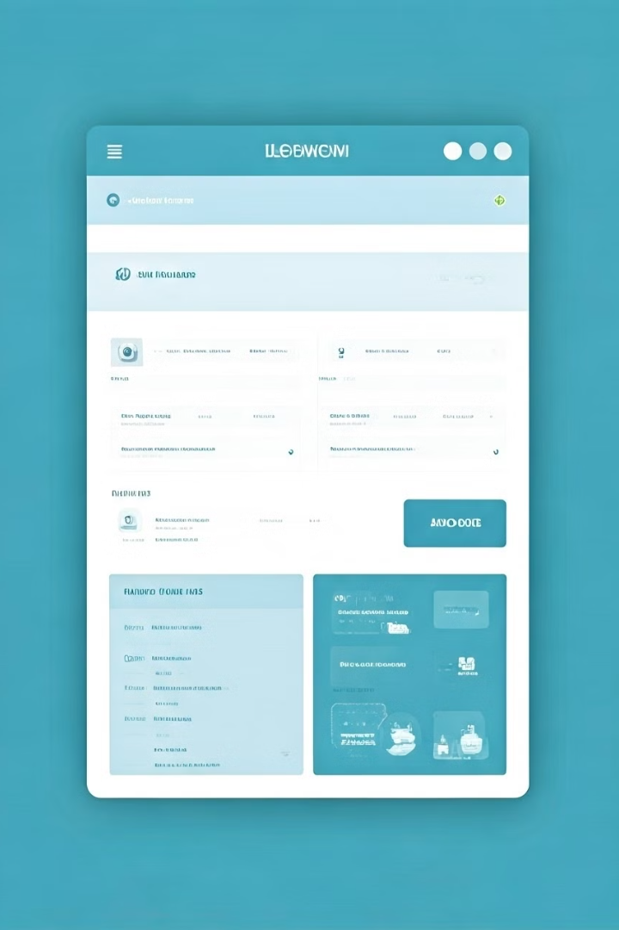
Flask/Streamlit Dashboard
Technology Stack
We utilize Flask or Streamlit for serving recommendations and an interactive dashboard for a user-friendly experience, ensuring ease of access and interaction.
Algorithms
Mood-to-food mapping and restaurant clustering algorithms are the core of our solution, ensuring personalized recommendations based on user preferences and mood.

Slide 9





Mood-Based Recommendations
User Input
The user selects their current mood, such as stress, laziness, or happiness, from a curated list of options.
Mood-to-Food Mapping
The system translates the selected mood into specific comfort foods, based on the Food Choices Dataset, identifying culinary preferences.
Restaurant Recommendation
The system combines the user's food preferences with the Zomato dataset to recommend restaurants that match their mood and location preferences.

Slide 10

Conclusion
By mapping moods to comfort foods and combining it with restaurant data, our system provides personalized dining recommendations for users. This innovative approach allows users to discover new restaurants that match their specific preferences and mood.

